Slide 1


EMPLOYEE RETENTION PREDICTION
Identifying Potential Job Change Among Data Scientists
Anshika Singh

Slide 2

PROBLEM STATEMENT
Modern organizations, especially in the data science industry, face a critical challenge: retaining skilled professionals in a highly competitive job market. Frequent employee turnover not only increases recruitment costs but also disrupts ongoing projects, reduces team efficiency, and affects long-term business growth.
This project aims to address the question: “Can we predict if a data scientist is likely to seek a job change?”
By identifying patterns and key factors influencing job change behavior, we aim to build a machine learning model that can proactively flag high-risk employees.
This enables HR teams and managers to take strategic actions in:
Talent retention,
Career path planning, and
Reducing costly turnover.
Ultimately, the goal is to enhance workforce stability and support data-driven HR decisions using predictive modeling and interpretability.

Slide 3

Retention Optimization | Recruitment Planning | Resource Allocation
Early identification of high-risk employees | Build proactive hiring pipelines | Direct efforts to impactful areas
BUSINESS OBJECTIVE

Slide 4

TABLE OF CONTENTS
Dataset Overview
Exploratory Data Analysis (EDA)
Data Preprocessing
Feature Engineering
Handling Imbalanced Target
Models Used
Evaluation Metrics
XGBoost Error Analysis
Feature Importance (XGBoost)
Final Model
Deployment: Streamlit App
Conclusion

Slide 5
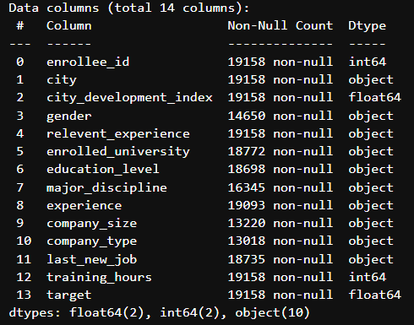
DATASET OVERVIEW
Dataset: aug_train.csv
Total Rows: 19158
Total Features (columns): 14
Target Variable: `target`
0 → Not looking for job change
1 → Looking for job change
Dataset contains demographic, education, work experience, and company-related information of job candidates.

Slide 6
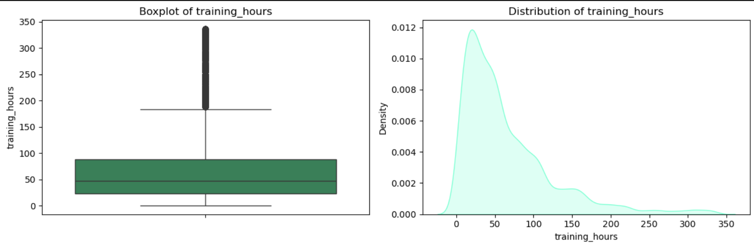
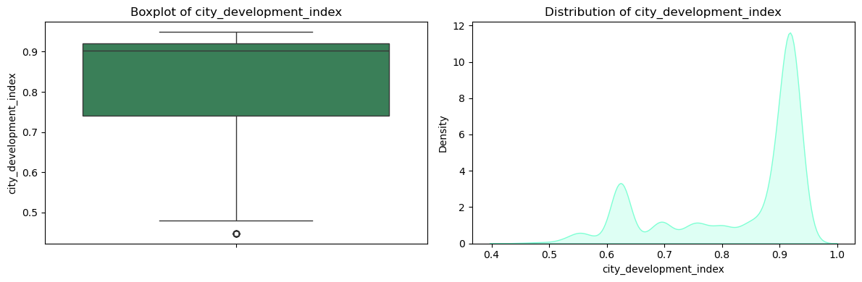
Exploratory Data Analysis (EDA)
Univariate Analysis (Numeric)
Insights from the Analysis:
Training Hours -
Right-skewed distribution — most candidates completed fewer training hours.
Several extreme outliers beyond 200+ hours.
Indicates a need for log transformation, which we applied later during feature engineering.
City Development Index -
Smooth, left-skewed distribution — most candidates come from moderately developed cities (index 0.6 to 0.9).
No significant outliers detected.
Suggests this feature is already scaled and ready for modeling.

Slide 7
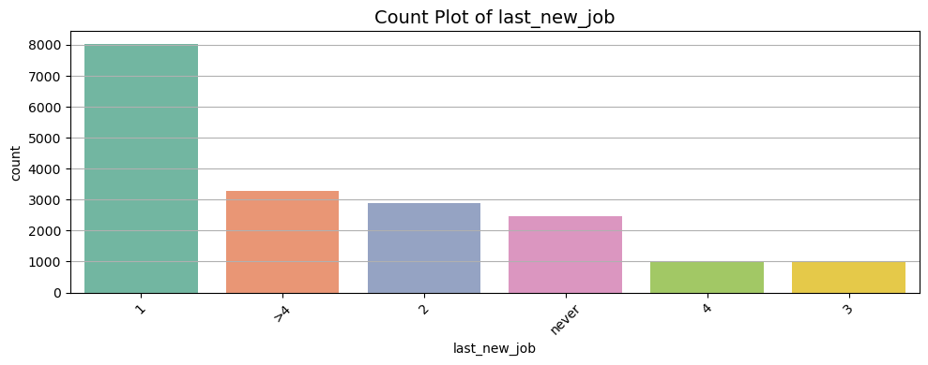
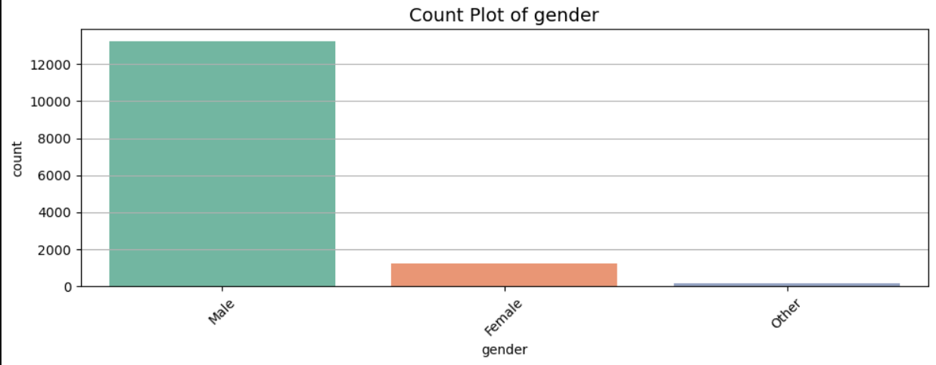
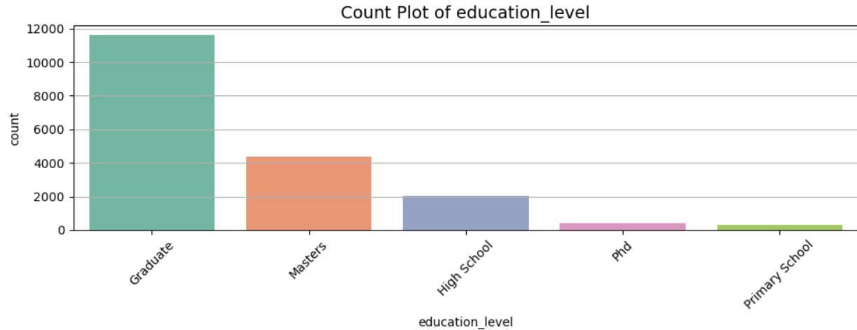
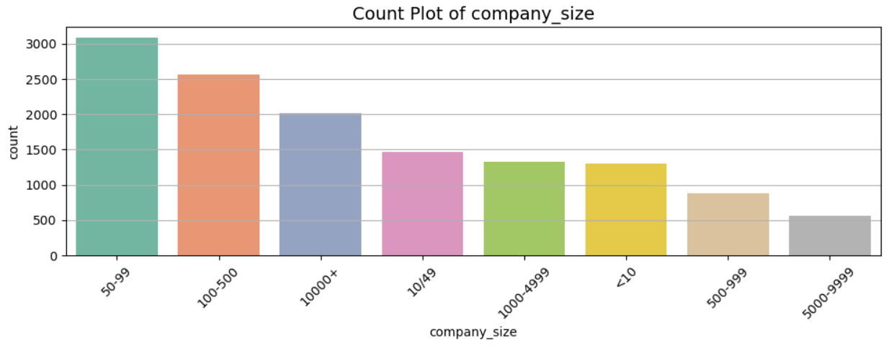
Exploratory Data Analysis (EDA)
Univariate Analysis (Categoric)

Slide 8
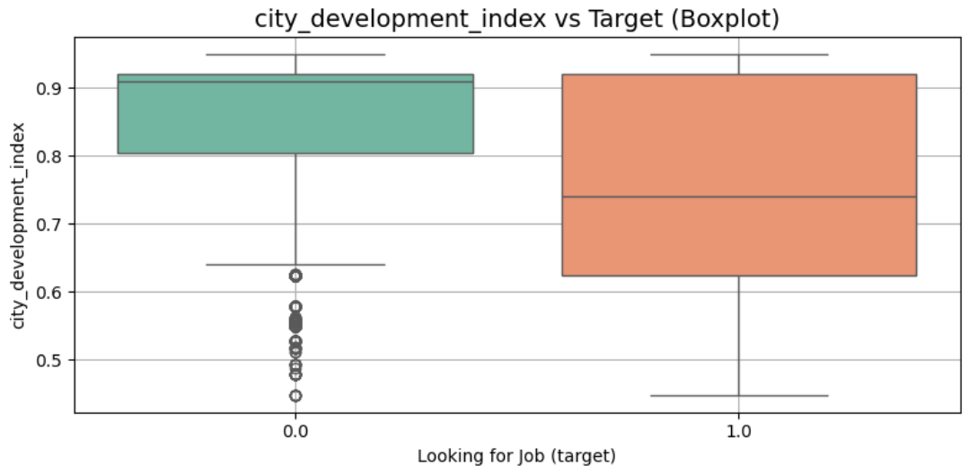
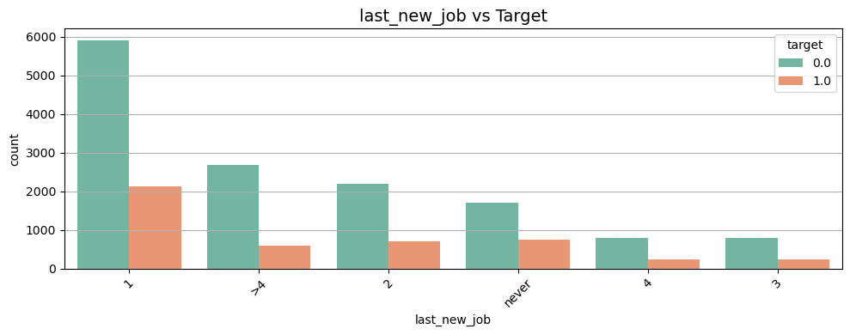
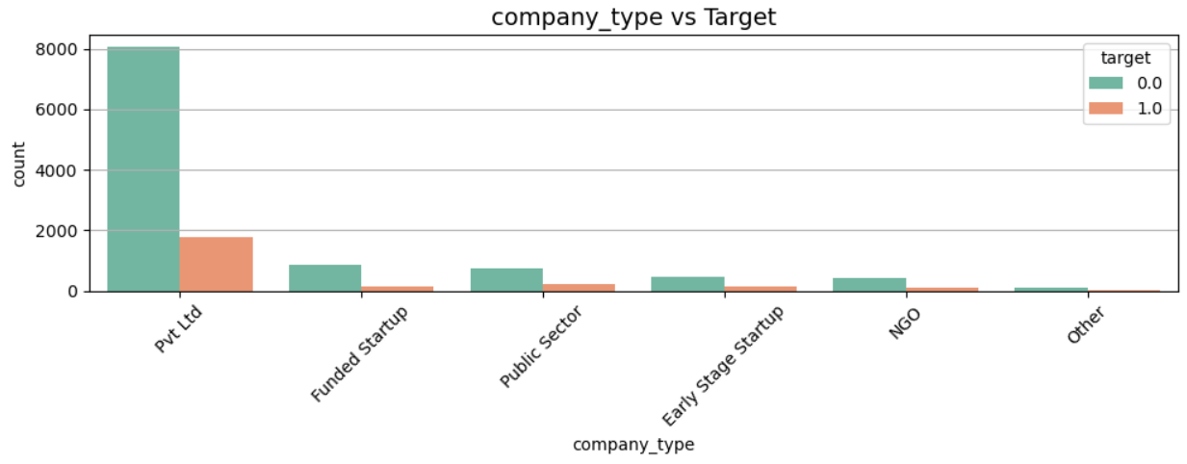
Exploratory Data Analysis (EDA)
Bivariate Analysis vs Target
Key Observations:
City Development Index vs Target:
The city development index shows a clear distinction between employees looking for a job and those not. Candidates from less developed cities (lower index) are more likely to seek job changes, while those from well-developed regions tend to stay. This suggests infrastructure or opportunity disparity may influence job retention.
Last New Job vs Target:
Candidates who changed jobs within the a year show a higher tendency to look for another change (target = 1).
Conversely, employees with no recent change (>4 or never) are less likely to leave. This highlights that frequent job switchers may be more volatile in retention.
Company Type vs Target:
Employees in Private Ltd companies form the majority of the dataset and also represent most job seekers. NGOs, early-stage startups, and public sector roles show relatively lower turnover, indicating company type and structure may influence stability.

Slide 9

DATA PREPROCESSING
Drop features
Handle missing values
Encode categorical variables
Treat Special Formats
Removed `enrollee_id` and `city` due to high cardinality and no predictive value.
Used mode/most frequent category for features like `education_level` and `last_new_job`.
Filled `gender`, `company_type`, and others with ‘Unknown’ or ‘Other’.
Ensured no nulls remainedafter this step.
Applied Label Encoding to categorical columns for simplicity.
Mapped categories for eg:
`gender`: Female → 0, Male → 1, Other → 2, Unknown → 3
etc.
Converted `experience`, `last_new_job`, and `company_size` from text to numeric.
e.g., ">20" → 21, "never" → 0
etc

Slide 10

Feature Engineering
(Performed After Initial Modeling & Error Analysis)
To enhance model performance and address patterns observed in error analysis (especially with XGBoost), the following feature engineering strategies were implemented:
New Features Created:
training_hours_log: Log-transformed training_hours to reduce skewness and normalize scale.
devindex_training_interaction: Interaction between city_development_index and training_hours to capture compounded development intensity and learning effort.
company_size_grouped: Rare company size values were grouped as "Other" to simplify noisy categories and improve generalization.
These transformations aimed to make the model more robust by reducing noise, handling skewed distributions, and incorporating meaningful interactions.
Feature engineering was guided by insights from XGBoost's feature importance and misclassification patterns seen in error analysis.

Slide 11
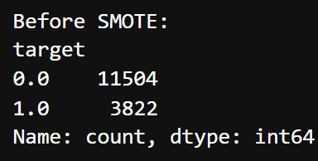
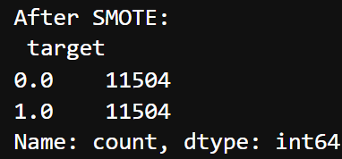
Handling Imbalanced Target
The target variable was imbalanced, with significantly more employees not looking for a job change.
To address this, SMOTE (Synthetic Minority Over-sampling Technique) was applied after the train-test split.
SMOTE synthetically created new samples of the minority class to ensure the model didn't become biased toward the majority class.
This improved recall and made evaluation metrics more balanced.
SMOTE (Synthetic Minority Over-sampling Technique) is a data augmentation method that creates synthetic examples of the minority class to balance class distribution in imbalanced datasets.

Slide 12
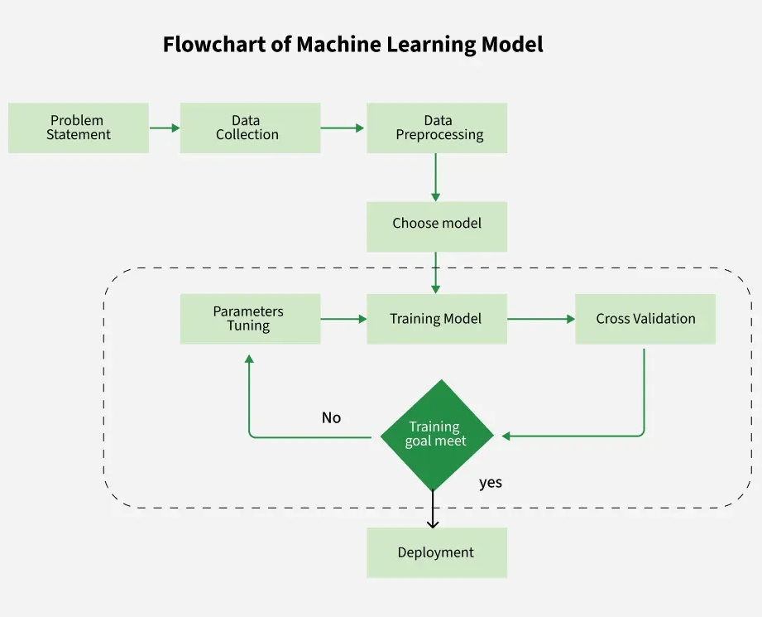
Models Used
Logistic Regression - A simple and interpretable linear model used as a baseline. It predicts the probability of a binary outcome and helps set a benchmark for more complex models. However, its limited capacity to capture non-linear relationships led to lower recall and overall performance.
Random Forest - An ensemble model that builds multiple decision trees and averages their outputs. It captures non-linear patterns well and is less prone to overfitting. In the project, it performed better than Logistic Regression, especially in balancing precision and recall, but was outperformed by gradient boosting models.
XGBoost - An advanced gradient boosting algorithm that builds trees sequentially, improving accuracy at each step. Known for its speed and performance, it offered strong recall and helped us perform feature importance analysis to guide later improvements.
LightGBM - A high-speed, high-efficiency gradient boosting model optimized for large datasets. It delivered the best standalone results in terms of accuracy and AUC in the project, especially handling the class imbalance well with better convergence than XGBoost.

Slide 13
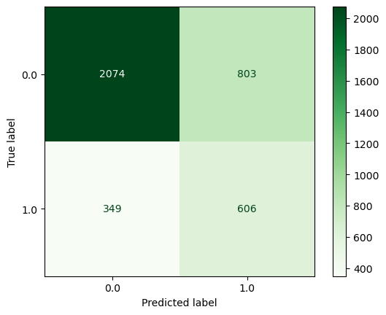
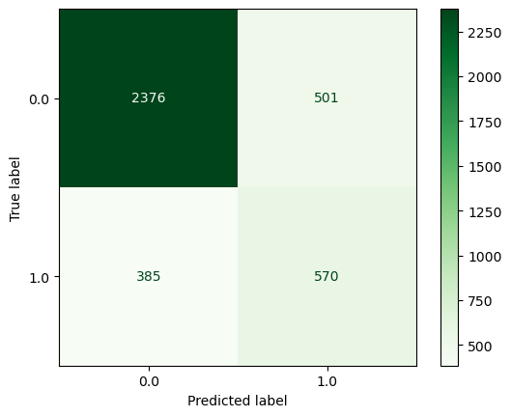
Evaluation metrics
Logistic Regression
Classification Report:
precision recall f1-score support
0.0 0.86 0.72 0.78 2877
1.0 0.43 0.63 0.51 955
accuracy 0.70 3832
macro avg 0.64 0.68 0.65 3832
weighted avg 0.75 0.70 0.72 3832
Accuracy Score: 0.6993736951983298
ROC-AUC Score: 0.6777223948011581
Accuracy: ~70%, ROC-AUC: ~0.67
Struggled with recall for class 1 (job changers)
Highlighted the need for more powerful classifiers
Random Forest
Classification Report:
precision recall f1-score support
0.0 0.86 0.83 0.84 2877
1.0 0.53 0.60 0.56 955
accuracy 0.77 3832
macro avg 0.70 0.71 0.70 3832
weighted avg 0.78 0.77 0.77 3832
Accuracy Score: 0.7687891440501043
ROC-AUC Score: 0.7113594549296005
Accuracy: ~76.8%, ROC-AUC: ~0.71
Better balanced performance with strong precision on majority class
Still showed moderate false positives

Slide 14
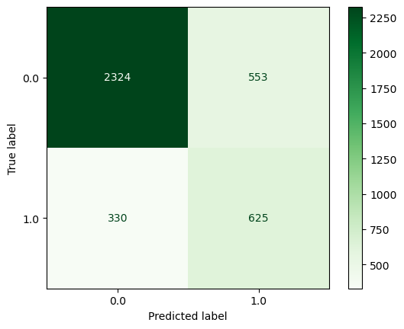
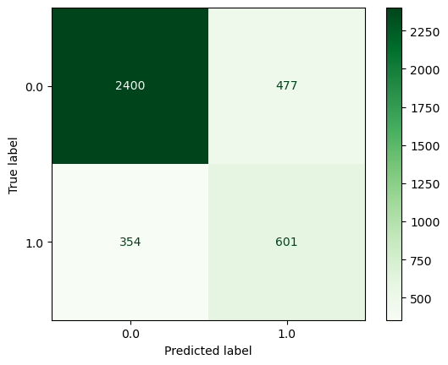
Evaluation metrics
XGBoost
Classification Report:
precision recall f1-score support
0.0 0.88 0.81 0.84 2877
1.0 0.53 0.65 0.59 955
accuracy 0.77 3832
macro avg 0.70 0.73 0.71 3832
weighted avg 0.79 0.77 0.78 3832
Accuracy Score: 0.769572025052192
ROC-AUC Score: 0.7311180749289818
Accuracy: ~76.9%, ROC-AUC: ~0.73
Improved recall on minority class
Feature importance insights led to better feature selection
LightGBM
Classification Report:
precision recall f1-score support
0.0 0.87 0.83 0.85 2877
1.0 0.56 0.63 0.59 955
accuracy 0.78 3832
macro avg 0.71 0.73 0.72 3832
weighted avg 0.79 0.78 0.79 3832
Accuracy Score: 0.7831419624217119
ROC-AUC Score: 0.7317608328920288
Accuracy: ~78.3%, ROC-AUC: ~0.73
Best standalone model with strong performance across all metrics
Outperformed others in handling class imbalance and convergence speed

Slide 15

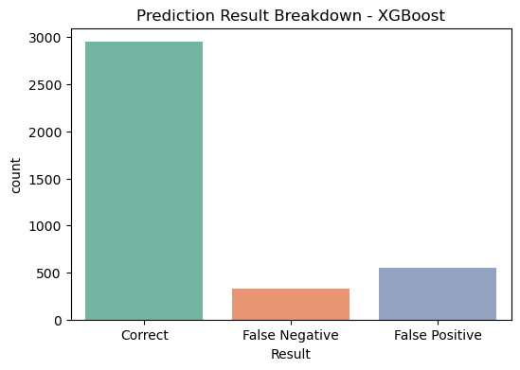
XGBoost Error Analysis
XGBoost Error analysis revealed two main problems:
A high number of false positives and false negatives.
Many misclassified candidates had mid-level training hours and average city development index.
Specific rows where predictions were incorrect were reviewed and this insight was used to update feature engineering and feature selection steps.
The error analysis shown here were performed on the earlier version of the XGBoost model (before final feature refinements). These insights helped shape decisions in later modeling stages.

Slide 16
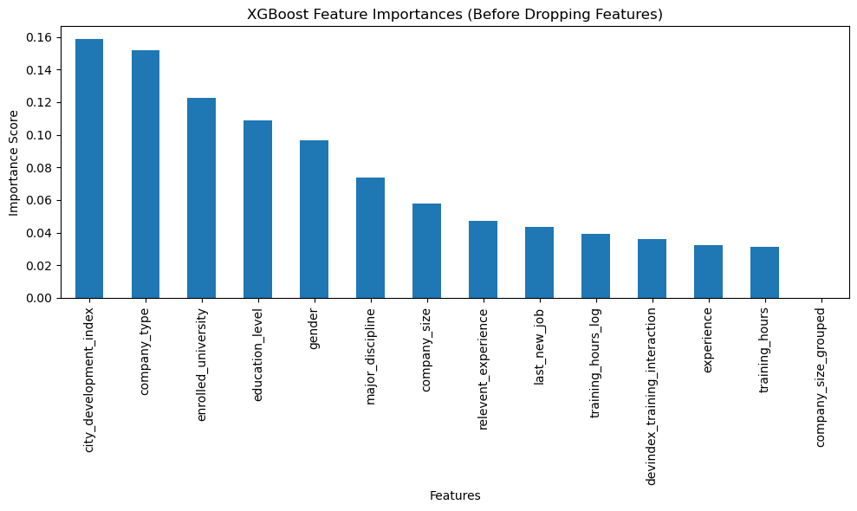
Feature Importance (XGBoost)
(Performed During XGBoost tuning stage)
After training XGBoost, the feature importances were visualized. The most influential features were:
city_development_index — indicating how developed a location is
education_level and company_type — capturing career prospects and employer quality
enrolled_university — indicating upskilling behavior
Though some features showed lower importance, it was chosen not to drop any ultimately in the final model for performance reason and to maintain interpretability

Slide 17
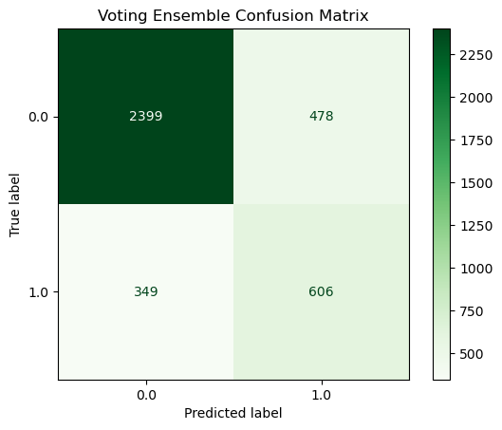
Final Model
Voting Ensemble (Soft Voting)
A soft voting ensemble combining the strengths of LightGBM and Random Forest, was used, assigning weights of [0, 4, 1] respectively.
XGBoost was excluded based on its lower recall and ROC-AUC in error analysis.
LightGBM was weighted higher due to its superior accuracy (78.3%) and balanced performance on both classes.
Random Forest added model diversity and slight improvement in generalization.
This gave the best overall performance:
Accuracy: 78.4%
Recall (Class 1): 63%
ROC-AUC: 0.734
This balanced both classes better and gives a robust final model for deployment.

Slide 18
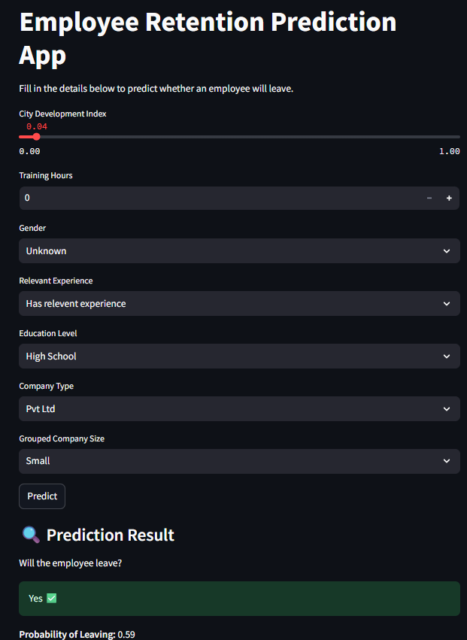
Deployment : Streamlit App
To make the solution interactive, the final model was deployed using Streamlit.
Users can input features and receive predictions on job change likelihood.
Encoders and the final model were saved and reused during inference.
The app was tested in a clean project structure using a virtual environment in VS Code.
This demonstrates the end-to-end lifecycle of a data science project—from data to production

Slide 19
CONCLUSION
Key Findings
City development index and education level are top predictors of job change.
Candidates with higher training hours and urban exposure are more likely to switch.
SMOTE helped handle class imbalance effectively.
Limitations
Dataset was relatively small (19k rows)
Some categorical distributions were highly skewed
External economic or company-level factors weren’t considered
Future Improvements
Use SHAP for deeper explainability
Add time-series patterns (if available)
Try advanced ensembling methods like stacking
Train on larger, more diverse datasets

Slide 20
THANK
YOU
Project by:
Anshika Singh

